Slide 1
SEMESTER FINAL PROJECT
XPNS — Expense Intelligence
Automating Financial Workflows for A.Z. Fashion
MAY 20, 2026

Slide 2
SEMESTER FINAL PROJECT
XPNS — Expense Intelligence
The Development Team
BUSINESS ANALYTICS & PYTHON DEVELOPMENT
Automating Financial Workflows for A.Z. Fashion
MAY 20, 2026

Slide 3








Meet the Contributors
Eman Ahmad
Rija Kunwar
Yumna Gul
FA25-BBD-037
FA25-BBD-132
FA25-BBD-173
Zainab Khalid
Isma Awais
FA25-BBD-161
FA25-BBD-063

Slide 4
Micro-Entrepreneur Case Study
A.Z. Fashion
A home-based boutique specializing in customized bridal and formal wear. Started in 2023, they manage high-value orders digitally via Instagram but rely on manual backend logging.
Digital/Home Operations
Custom Tailoring Focus
20-25 Monthly Orders

Slide 5






Problem Identification
Manual Logs
Financial Mix
Delayed Entry
Paper notebooks are prone to damage and lack long-term query capabilities.
Business and household expenses are often mixed, clouding profit visibility.
Small daily expenses are often forgotten, leading to inaccurate cost calculations.

Slide 6
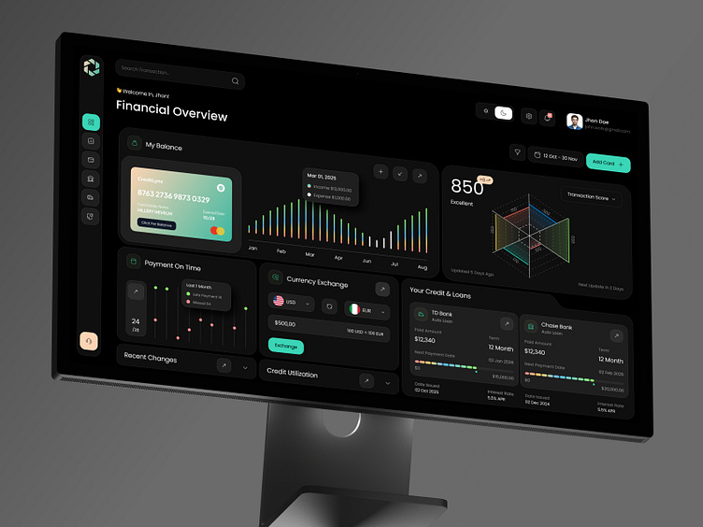
XPNS Digital Ecosystem
Intelligence-Driven Tracking
XPNS provides a full-stack solution to replace the manual notebook system. By categorizing every PKR spent, the entrepreneur gains instant clarity on the real cost of every bridal order.
•
Automated JSON data persistence
•
Live category breakdown visualization
•
Excel interoperability for financial audits

Slide 7

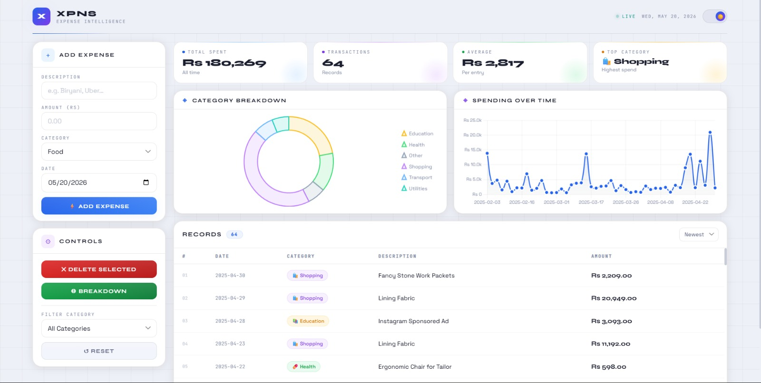
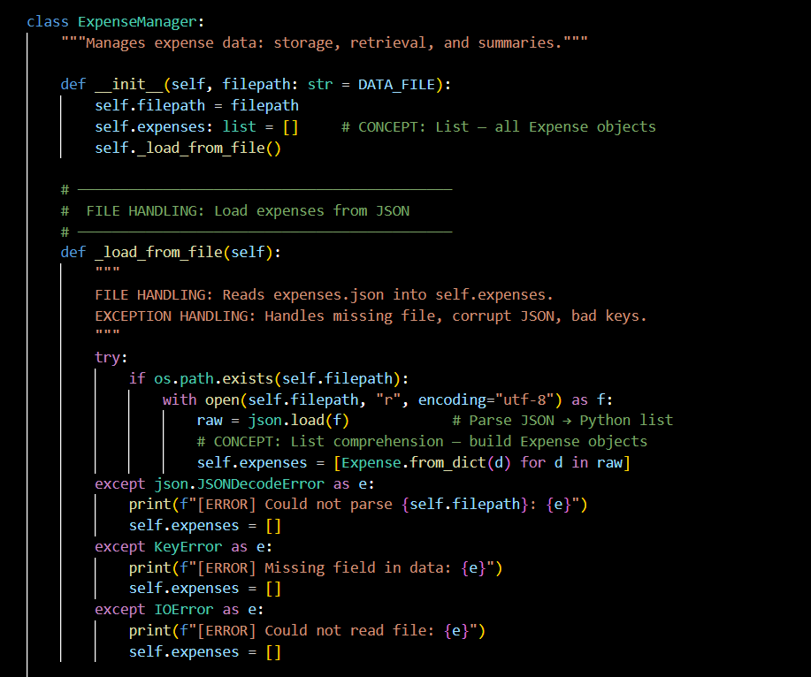
XPNS Digital Ecosystem

Slide 8
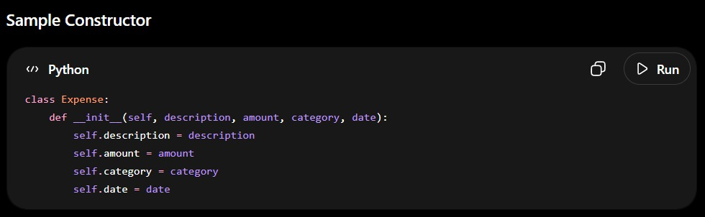
Object-Oriented Design
Modular Excellence
We utilized OOP principles to model the business domain into clean, reusable entities.
Expense Class: Encapsulates individual records with ID, Amount, Category, and Date.
ExpenseManager: The central controller handling data logic, filtering, and summarization.

Slide 9
Expense Class
Purpose Encapsulates all information related to one expense entry.
Expense Class — Digital Expense Record
Key Attributes ✔️ Expense ID✔️ Description✔️ Amount✔️ Category✔️ Date
The Expense class models a single business expense.

Slide 10


Expense Object Example
Expense Object in Action Each expense becomes an object.
How It Works
User enters data
Example Record { "description": "Fabric Purchase", "amount": 8500, "category": "Shopping", "date": "2026-05-10"}
→Expense object is created
Business Benefit Every transaction becomes a structured and searchable record.
Object is stored and managed by the system.

Slide 11
Expense Manager Class
Expense Manager — System Brain
The Expense Manager class controls the complete workflow.
Core Responsibilities ✔️ Store expense objects ✔️ Validate inputs ✔️ Save and load files ✔️ Filter records ✔️Calculate summaries ✔️ Handle deletion
Main Function
✔️ add_expense() ✔️ get_all() ✔️filter_by_category() ✔️ delete_expense() ✔️calculate_summary() ✔️Design Benefit
Centralized logic improves system maintainability.

Slide 12
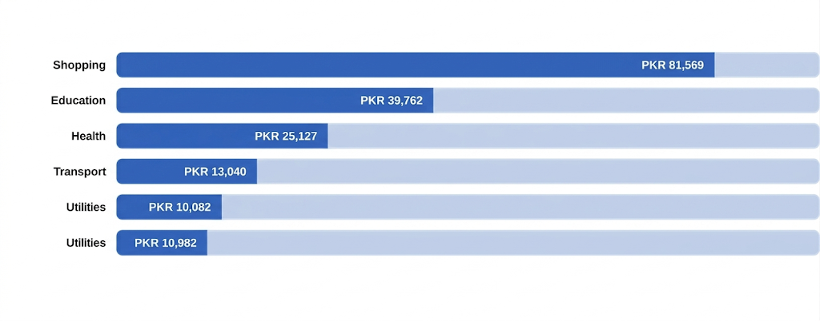
Strategic Expense Breakdown
"Shopping" (Fabric/Material) represents the primary cost driver for A.Z. Fashion operations.

Slide 13
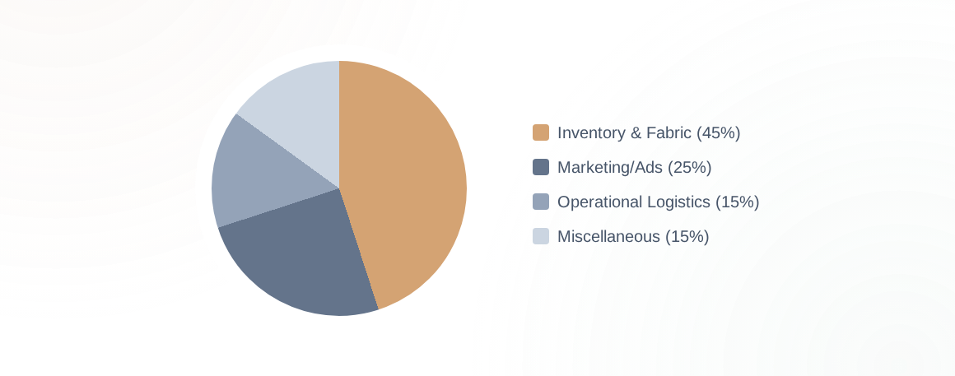
Budget Allocation Proportions

Slide 14

System Stability & Integrity
100%
Crash-Proof Reliability
Built with robust try-except blocks at every entry point. The system never crashes on invalid inputs, ensuring A.Z. Fashion's data remains safe even during user errors.
EXCEPTION HANDLING COVERAGE

Slide 15
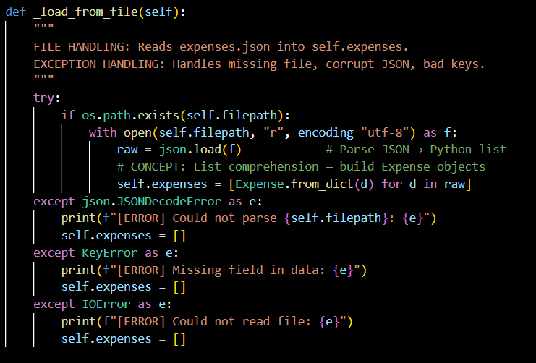
Exception Handling

Slide 16
Questions?
XPNS — FINAL SEMESTER PROJECT
COMSATS University Islamabad | Fall 2025

